Slide 1
FSW Canard Configuration in Level Flight (HA144A), Shell element model
Static aeroelastic solution to the sample problem in the Nastran Aeroelasticity User Manual
Admir Makas

Slide 2
Introduction
Sample problem HA144A from the aeroelasticity MSC Nastran manual.
Solution type is 144 (Static aeroelasticity analysis)
Forward swept wing canard configuration considered
Fuselage and wing structure modelled using beam and shell elements
Three level flight conditions evaluated
Subsonic, low speed
Subsonic, high speed (transonic region)
Supersonic
Solutions obtained by following methods:
Doublet-Lattice (Subsonic)
ZONA51 (Supersonic)

Slide 3
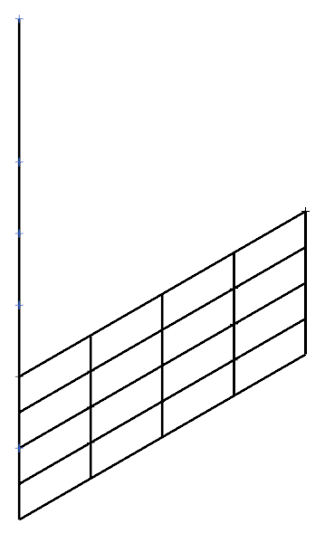
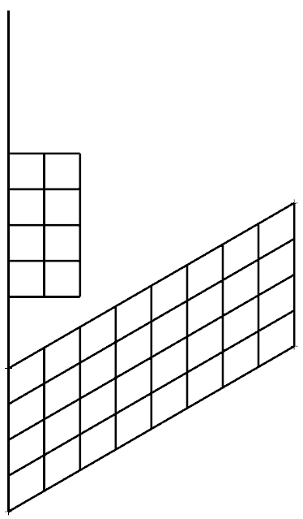
Model Details
Structural Model
(Modeled with beam & shell elements)
Aerodynamic Model
M=1500
0, 0, 0
Canard:
Aspect ratio = 1
Chord = 10 ft
Latice Div = 4 by 2
Wing:
Aspect ratio = 4
Chord = 10 ft
Area = 200 ft^2
Latice Div = 8 by 4
M=1500
18.840, 15, 0
10, 0, 0
Reference node for rigid body modes
M=600
15, 0, 0
Length=30 ft
M=1500
20, 0, 0
24.613, 5, 0
M=600
M=1500
M=400
30, 0, 0
23.840, 15, 0
Ang = 30
M=400
29.613, 5, 0

Slide 4
Node and Element Details
Node Coordinates
Node # | X | Y | Z
1 | 0 | 0 | 0
2 | 10 | 0 | 0
3 | 15 | 0 | 0
4 | 20 | 0 | 0
5 | 25 | 0 | 0
6 | 27.5 | 0 | 0
7 | 30 | 0 | 0
8 | 32.5 | 0 | 0
9 | 35 | 0 | 0
10 | 22.113 | 5 | 0
11 | 24.613 | 5 | 0
12 | 27.113 | 5 | 0
13 | 29.613 | 5 | 0
14 | 32.113 | 5 | 0
15 | 19.225 | 10 | 0
16 | 21.727 | 10 | 0
17 | 24.225 | 10 | 0
18 | 26.727 | 10 | 0
19 | 29.225 | 10 | 0
20 | 16.338 | 15 | 0
21 | 18.840 | 15 | 0
22 | 21.340 | 15 | 0
23 | 23.840 | 15 | 0
24 | 26.338 | 15 | 0
25 | 13.450 | 20 | 0
26 | 15.954 | 20 | 0
27 | 18.450 | 20 | 0
28 | 20.954 | 20 | 0
29 | 23.450 | 20 | 0
1
Circled nodes are used for the splining operation.
1
2
2
25
3
26
20
12
3
21
27
15
11
16
4
22
28
10
10
16
15
20
4
29
17
19
23
24
5
9
11
14
5
18
24
6
13
12
18
23
X
6
13
19
7
17
22
7
14
8
21
Y
8
9

Slide 5
Material Properties
Trim Conditions
Isotropic material:
E = 1.44x10^9 lb/ft^2
G = 5.40x10^8 lb/ft^2
Beam properties (FUSELAGE):
A = 2.0 ft^2
Iy = 0.173611 ft^4
Iz = 0.15 ft^4
J = 0.5 ft^4
Shell properties (WING):
Thickness = 0.3 ft
TRIM 1 (Subsonic)
MACH = 0.9
Flight Dynamic Pressure (q) = 1200 lb/ft^2
TRIM 2 (Low speed characteristics):
MACH = 0.9
Flight Dynamic Pressure (q) = 40 lb/ft^2
TRIM 3 (Supersonic):
MACH = 1.3
Flight Dynamic Pressure (q) = 1151 lb/ft^2

Slide 6
Experimental Corrections
Considered example utilizes correction factor matrices, which are meant to account for the differences between test and theory.
MSC manual provides the values for the following matrices:
WKK = matrix of correction factors to adjust lift calculations [80 by 80 diagonal matrix]. In this example all diagonal values equal to 1. Off-diagonal values are zero.
W2GJ = vector defining the incidence of the lifting surface [1 by 40 vector]. In this example incidence of the wing is 0.1 Deg (0.0017453 Rad) while canard incidence is equal to 0 Deg. Therefore first 8 rows are set to zero (they correspond to the canard).
FA2J = vector defining additive experimentally obtained pressure coefficient terms. In this case this vector is set to 0 for all rows.
The size of the matrices and vectors are based on the number or boxes defined for the aerodynamic model. In this case there are total of 40 boxes defined in the model.
Matrix WKK has the size of 80 by 80 because analysis assumes a top and bottom surface.
For vectors W2GJ and FA2J there are three columns. This is because three trim conditions are evaluated.

Slide 7
Result Comparison Between Beam and Shell Model

Slide 8
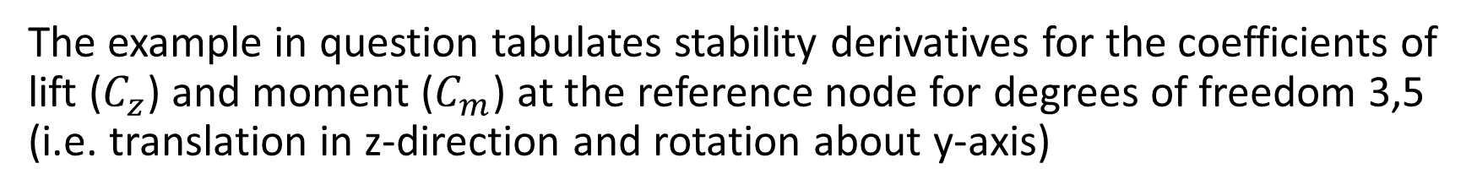
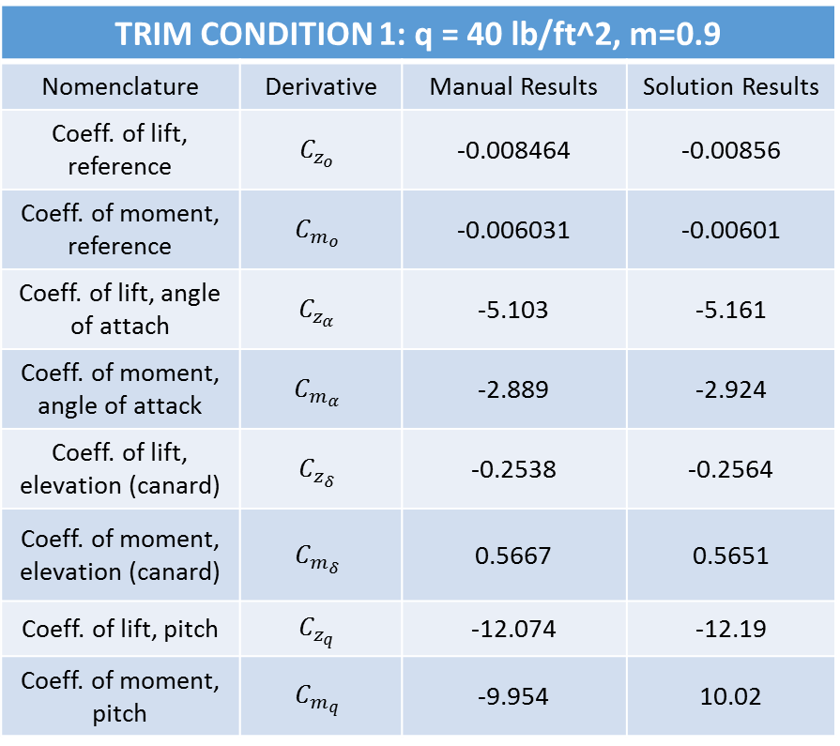
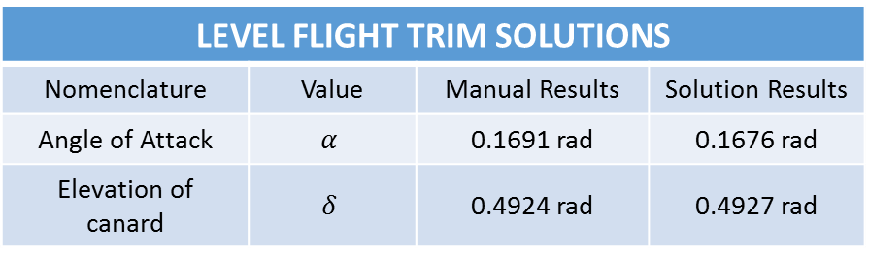
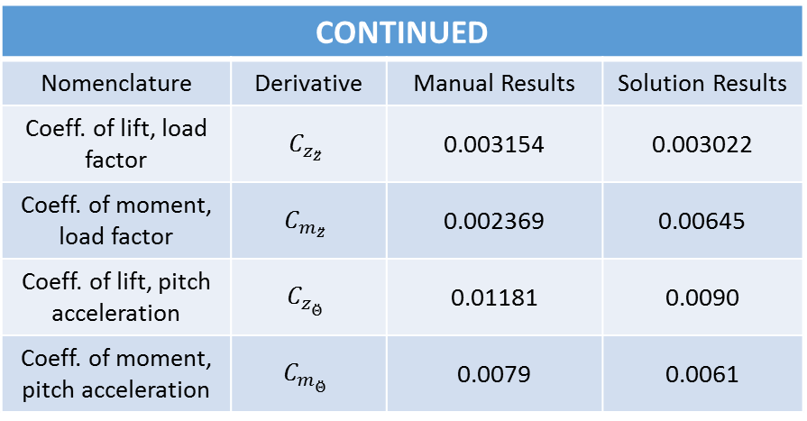
Results
The example in question tabulates stability derivatives for the coefficients of lift ($C_{z}$) and moment ($C_{m}$) at the reference node for degrees of freedom 3,5 (i.e. translation in z-direction and rotation about y-axis)
TRIM CONDITION 1: q = 40 lb/ft^2, m=0.9
Nomenclature | Derivative | Manual Results | Solution Results
Coeff. of lift, reference | $$C_{z_{o}}$$ | -0.008464 | -0.00856
Coeff. of moment, reference | $$C_{m_{o}}$$ | -0.006031 | -0.00601
Coeff. of lift, angle of attach | $$C_{z_{α}}$$ | -5.103 | -5.161
Coeff. of moment, angle of attack | $$C_{m_{α}}$$ | -2.889 | -2.924
Coeff. of lift, elevation (canard) | $$C_{z_{δ}}$$ | -0.2538 | -0.2564
Coeff. of moment, elevation (canard) | $$C_{m_{δ}}$$ | 0.5667 | 0.5651
Coeff. of lift, pitch | $$C_{z_{q}}$$ | -12.074 | -12.19
Coeff. of moment, pitch | $$C_{m_{q}}$$ | -9.954 | 10.02
CONTINUED
Nomenclature | Derivative | Manual Results | Solution Results
Coeff. of lift, load factor | $$C_{z_{\ddot{z}}}$$ | 0.003154 | 0.003022
Coeff. of moment, load factor | $$C_{m_{\ddot{z}}}$$ | 0.002369 | 0.00645
Coeff. of lift, pitch acceleration | $$C_{z_{\ddot{Θ}}}$$ | 0.01181 | 0.0090
Coeff. of moment, pitch acceleration | $$C_{m_{\ddot{Θ}}}$$ | 0.0079 | 0.0061
LEVEL FLIGHT TRIM SOLUTIONS
Nomenclature | Value | Manual Results | Solution Results
Angle of Attack | $$α$$ | 0.1691 rad | 0.1676 rad
Elevation of canard | $$δ$$ | 0.4924 rad | 0.4927 rad

Slide 9

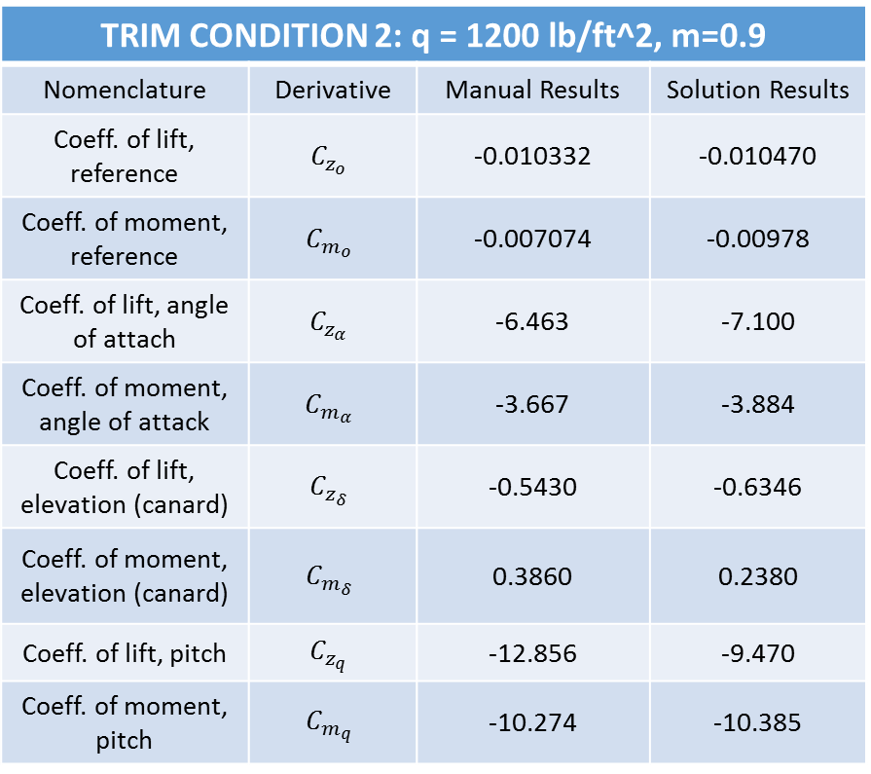
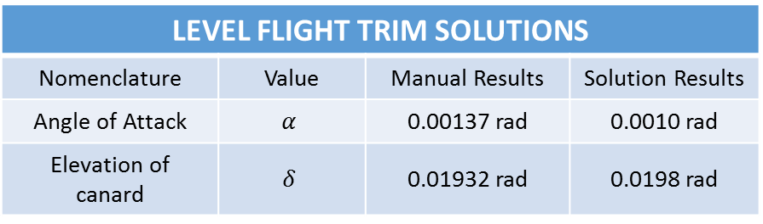
Results, Cont.
TRIM CONDITION 2: q = 1200 lb/ft^2, m=0.9
Nomenclature | Derivative | Manual Results | Solution Results
Coeff. of lift, reference | $$C_{z_{o}}$$ | -0.010332 | -0.010470
Coeff. of moment, reference | $$C_{m_{o}}$$ | -0.007074 | -0.00978
Coeff. of lift, angle of attach | $$C_{z_{α}}$$ | -6.463 | -7.100
Coeff. of moment, angle of attack | $$C_{m_{α}}$$ | -3.667 | -3.884
Coeff. of lift, elevation (canard) | $$C_{z_{δ}}$$ | -0.5430 | -0.6346
Coeff. of moment, elevation (canard) | $$C_{m_{δ}}$$ | 0.3860 | 0.2380
Coeff. of lift, pitch | $$C_{z_{q}}$$ | -12.856 | -9.470
Coeff. of moment, pitch | $$C_{m_{q}}$$ | -10.274 | -10.385
CONTINUED
Nomenclature | Derivative | Manual Results | Solution Results
Coeff. of lift, load factor | $$C_{z_{\ddot{z}}}$$ | 0.003634 | 0.00160
Coeff. of moment, load factor | $$C_{m_{\ddot{z}}}$$ | 0.002624 | 0.0010
Coeff. of lift, pitch acceleration | $$C_{z_{\ddot{Θ}}}$$ | 0.01449 | 0.0093
Coeff. of moment, pitch acceleration | $$C_{m_{\ddot{Θ}}}$$ | 0.009404 | 0.0086
LEVEL FLIGHT TRIM SOLUTIONS
Nomenclature | Value | Manual Results | Solution Results
Angle of Attack | $$α$$ | 0.00137 rad | 0.0010 rad
Elevation of canard | $$δ$$ | 0.01932 rad | 0.0198 rad

Slide 10
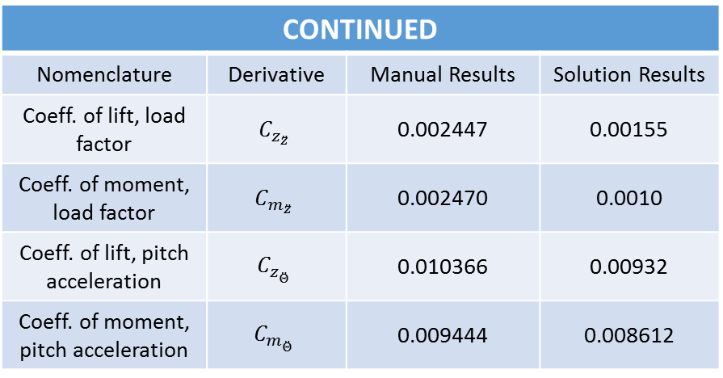
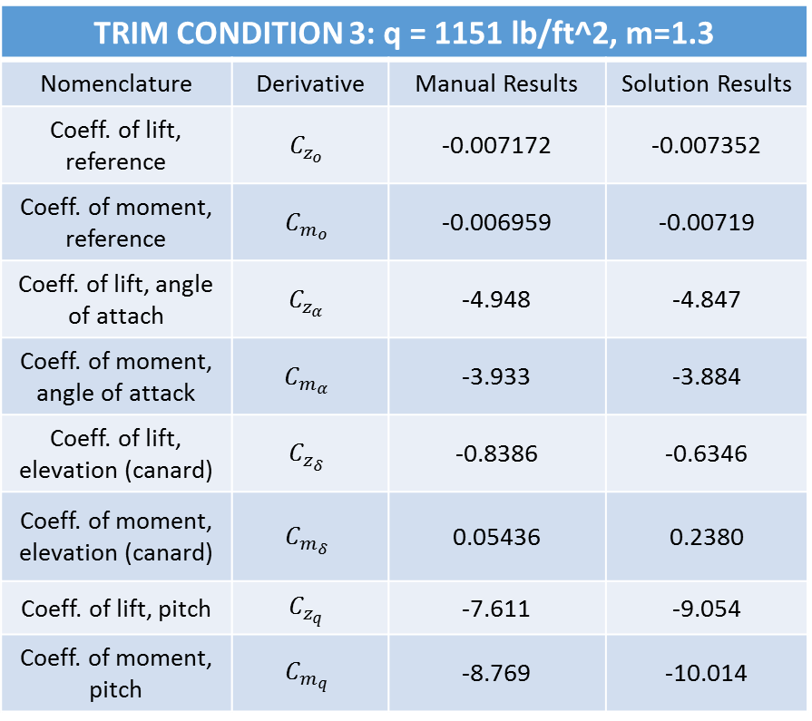
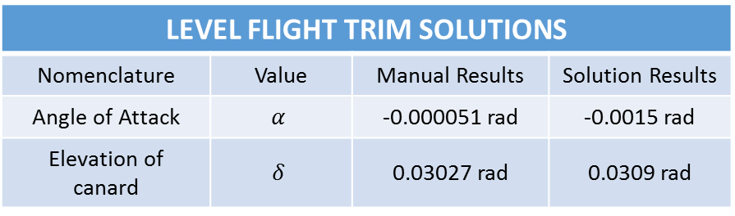
Results, Cont.
TRIM CONDITION 3: q = 1151 lb/ft^2, m=1.3
Nomenclature | Derivative | Manual Results | Solution Results
Coeff. of lift, reference | $$C_{z_{o}}$$ | -0.007172 | -0.007352
Coeff. of moment, reference | $$C_{m_{o}}$$ | -0.006959 | -0.00719
Coeff. of lift, angle of attach | $$C_{z_{α}}$$ | -4.948 | -4.847
Coeff. of moment, angle of attack | $$C_{m_{α}}$$ | -3.933 | -3.884
Coeff. of lift, elevation (canard) | $$C_{z_{δ}}$$ | -0.8386 | -0.6346
Coeff. of moment, elevation (canard) | $$C_{m_{δ}}$$ | 0.05436 | 0.2380
Coeff. of lift, pitch | $$C_{z_{q}}$$ | -7.611 | -9.054
Coeff. of moment, pitch | $$C_{m_{q}}$$ | -8.769 | -10.014
CONTINUED
Nomenclature | Derivative | Manual Results | Solution Results
Coeff. of lift, load factor | $$C_{z_{\ddot{z}}}$$ | 0.002447 | 0.00155
Coeff. of moment, load factor | $$C_{m_{\ddot{z}}}$$ | 0.002470 | 0.0010
Coeff. of lift, pitch acceleration | $$C_{z_{\ddot{Θ}}}$$ | 0.010366 | 0.00932
Coeff. of moment, pitch acceleration | $$C_{m_{\ddot{Θ}}}$$ | 0.009444 | 0.008612
LEVEL FLIGHT TRIM SOLUTIONS
Nomenclature | Value | Manual Results | Solution Results
Angle of Attack | $$α$$ | -0.000051 rad | -0.0015 rad
Elevation of canard | $$δ$$ | 0.03027 rad | 0.0309 rad

